Slide 1
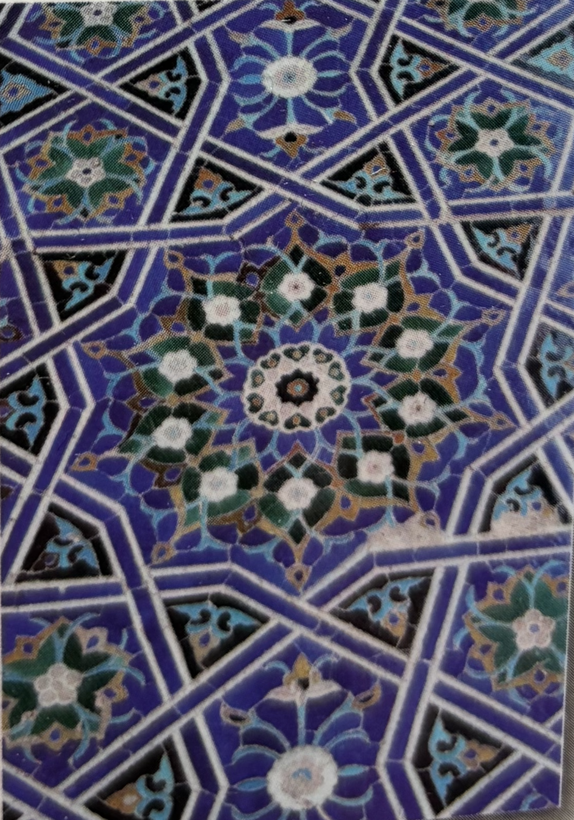
Triangles and Sacred Geometry in Islamic Art
Aïsha G.
1

Slide 2
The expansion of the universe
2

Slide 3
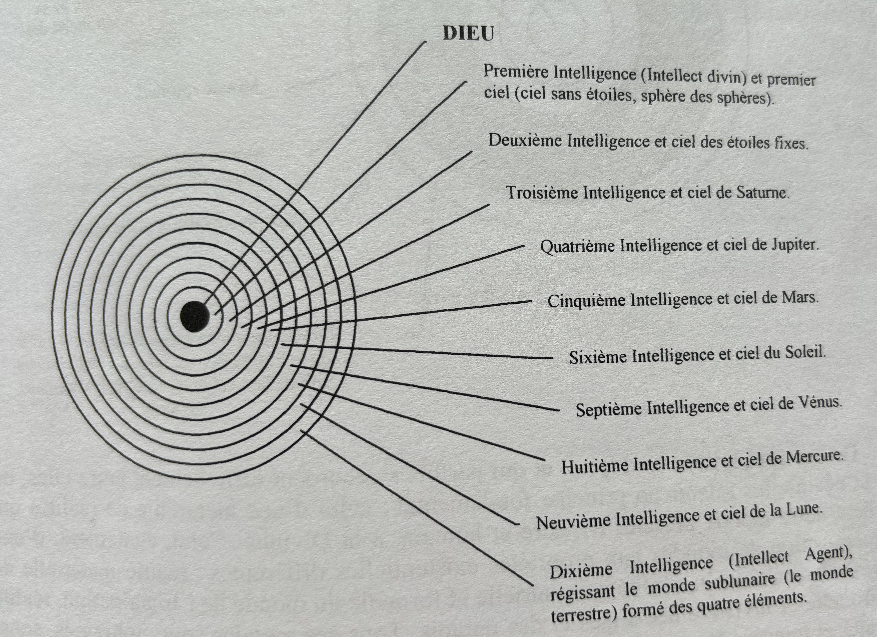
The radiating concentric circles
3

Slide 4
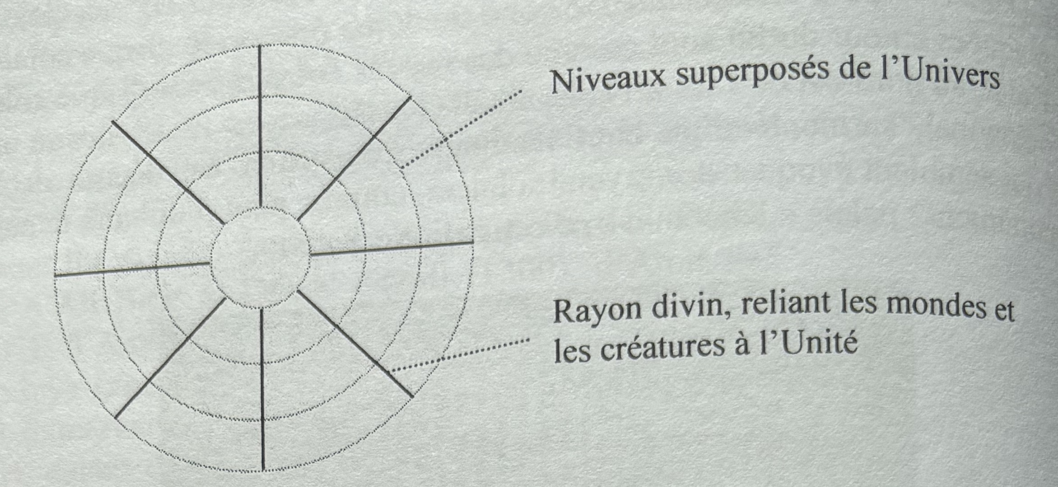
Rotative triangles
4

Slide 5
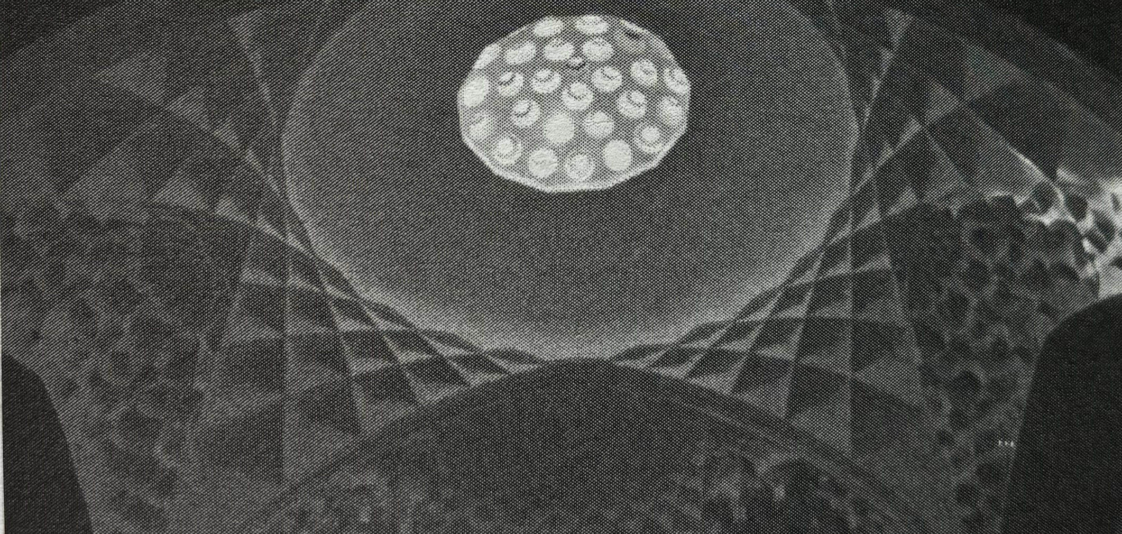
The Muqarnas
Hammam Gandj-e Ali Khân, Iran (1611-12)
5

Slide 6
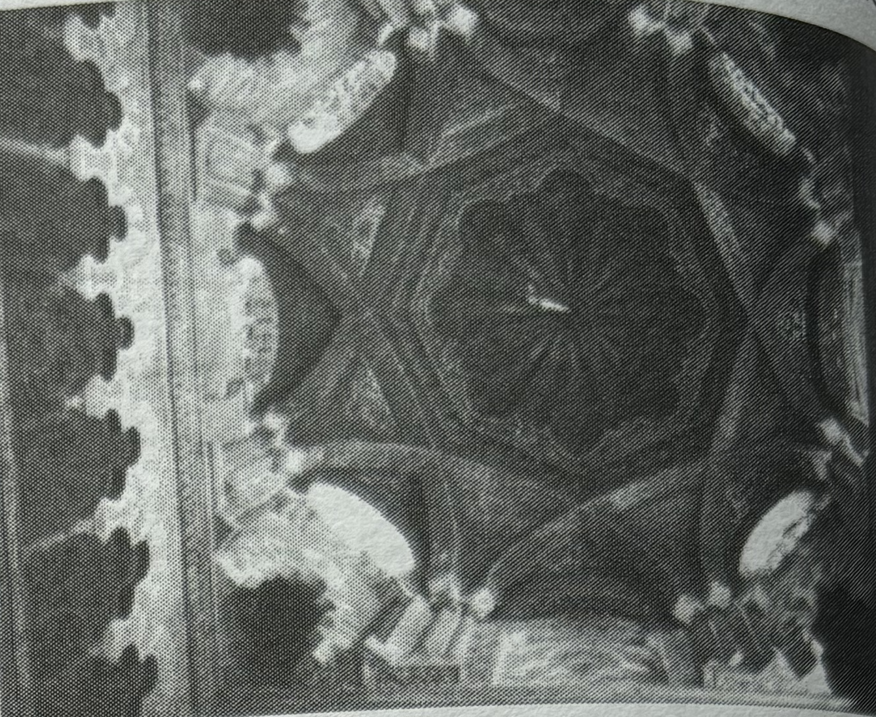
Mosque of Cordoba, Spain, 10th century
6

Slide 7
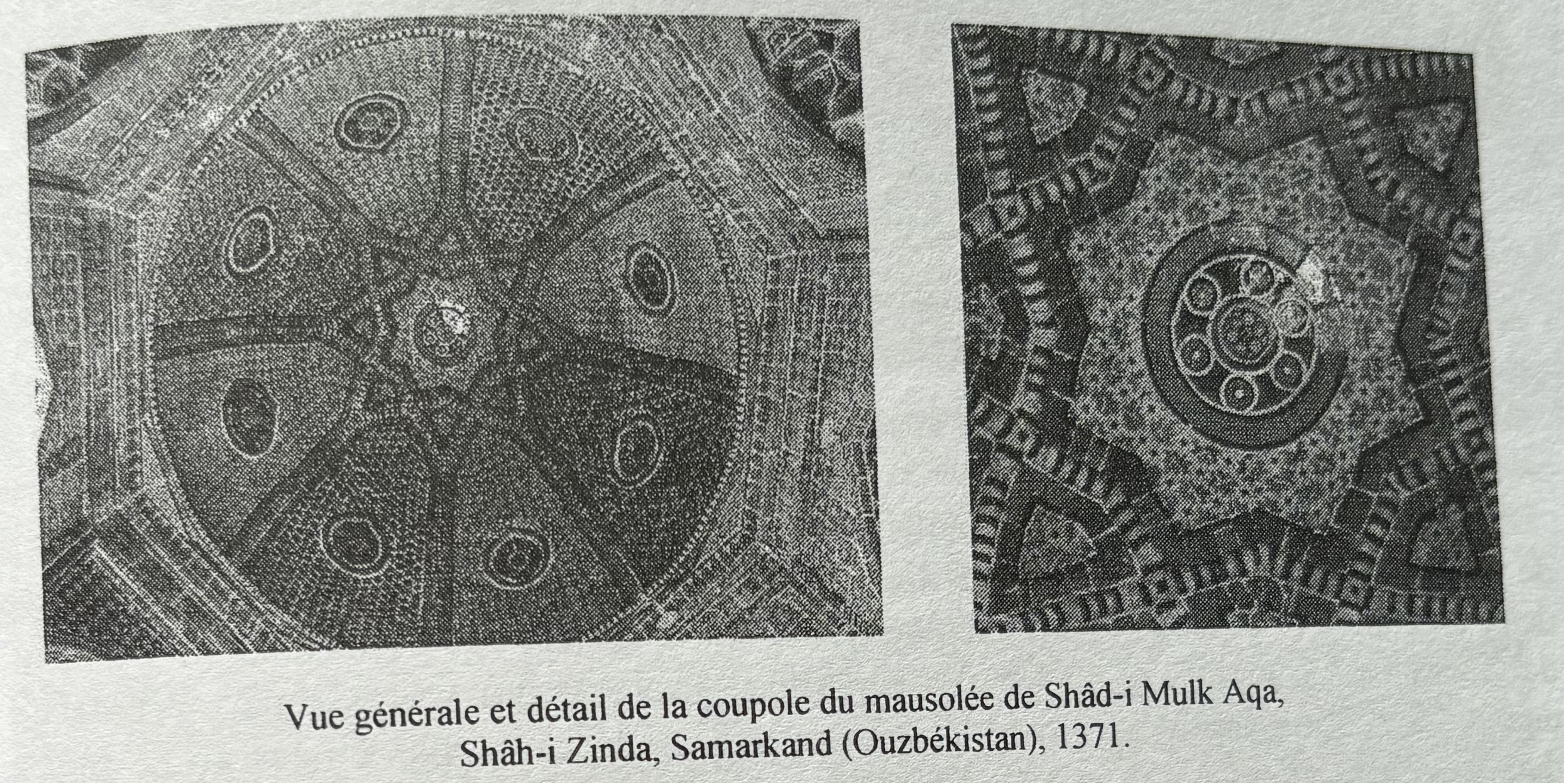
Domes
Samarkand mausoleum, Uzbekistan (1371)
7

Slide 8
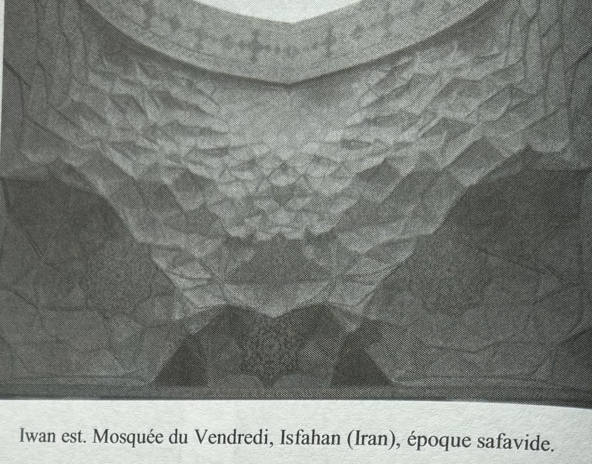
Muqarnas of a mosque in Isfahan
8

Slide 9
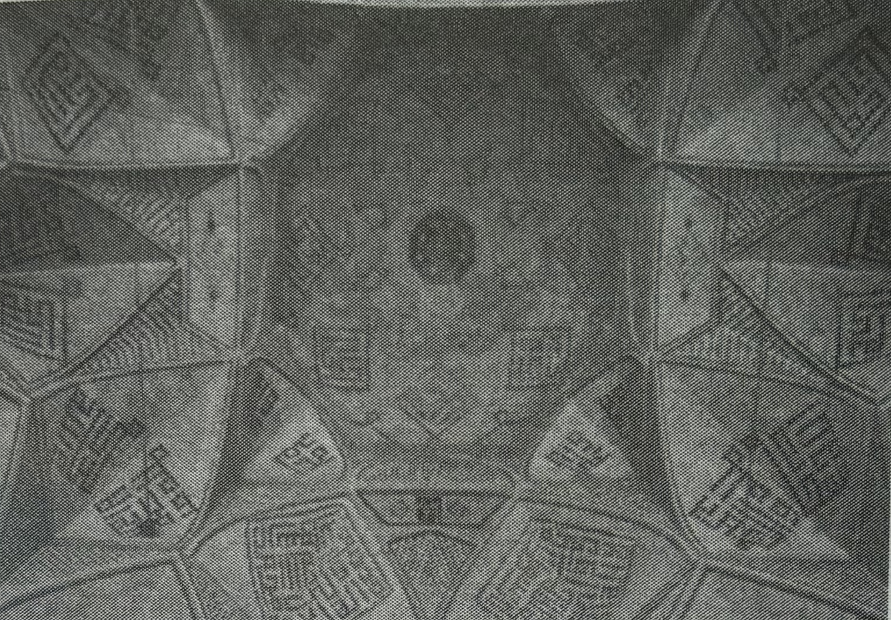
Friday Mosque, Isfahan (Iran) 15th century
9

Slide 10
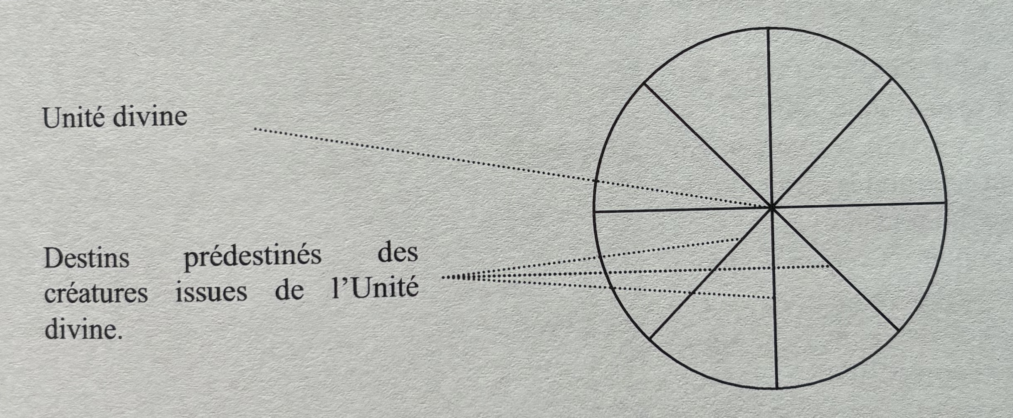
Frome the One (divine unity)
To Many
10

Slide 11
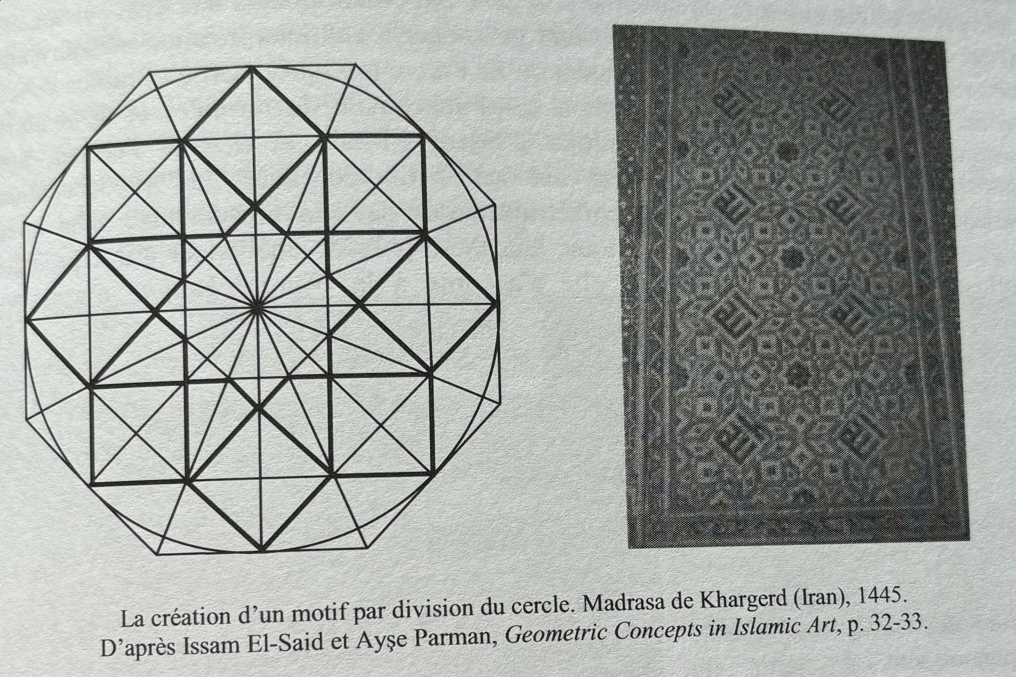
The Spiderweb
11

Slide 12
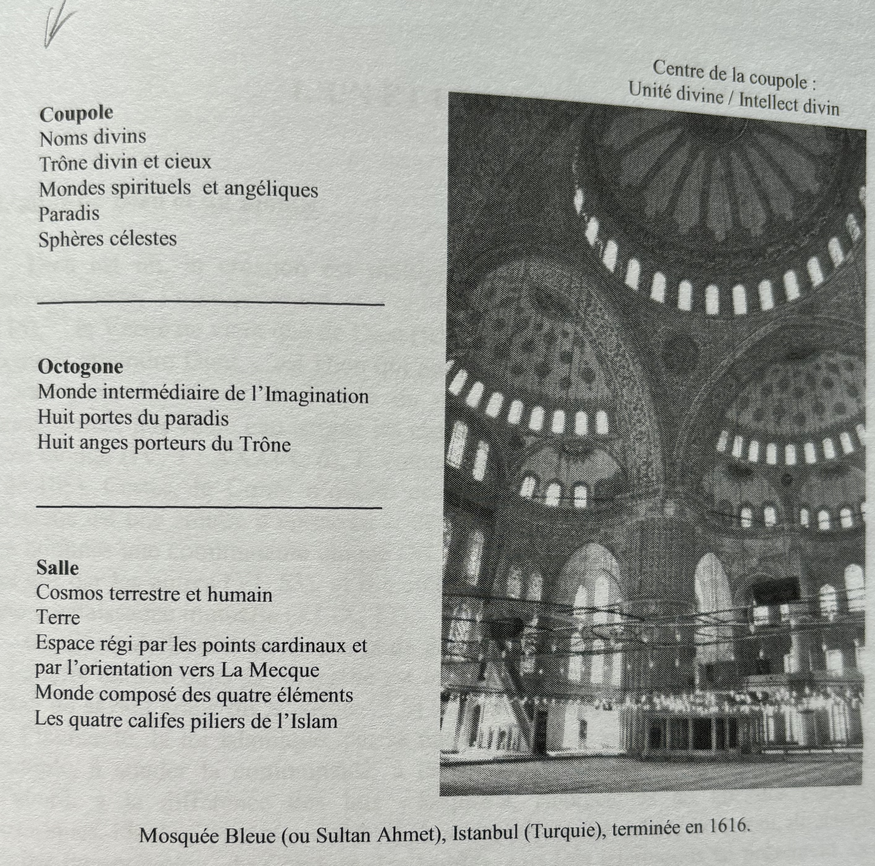
The symbolic structure of the Blue Mosque, Istanbul (Turkey)
17th century.
The Dome
----------------
The Octagon
----------------
The Prayer
Room
12

Slide 13
Thank You
13

